Slide 1

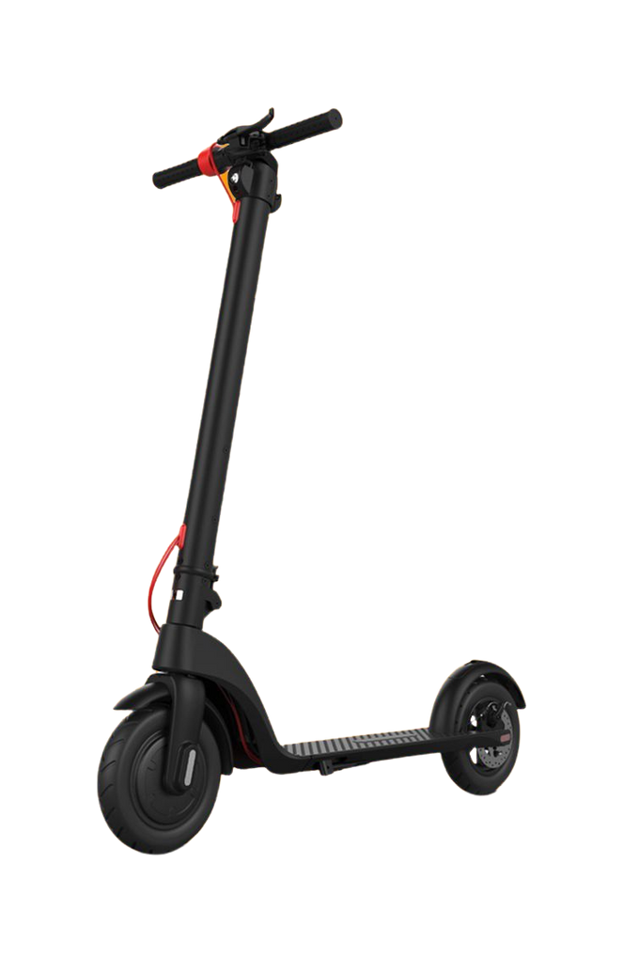
E-scoot
Marketing plan

Slide 2
Table Of Content
Our Team
SWOT Analysis
Bussiness Brief
Competitor Analysis
7 Questions
STP
Branding
4ps

Slide 3
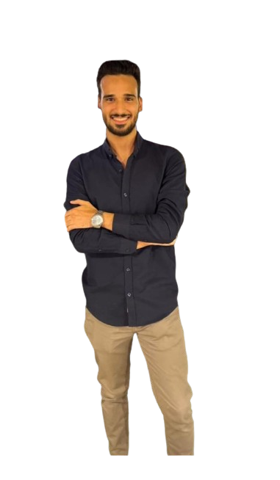
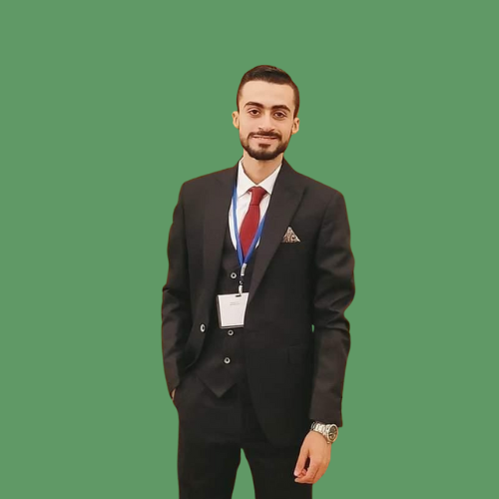
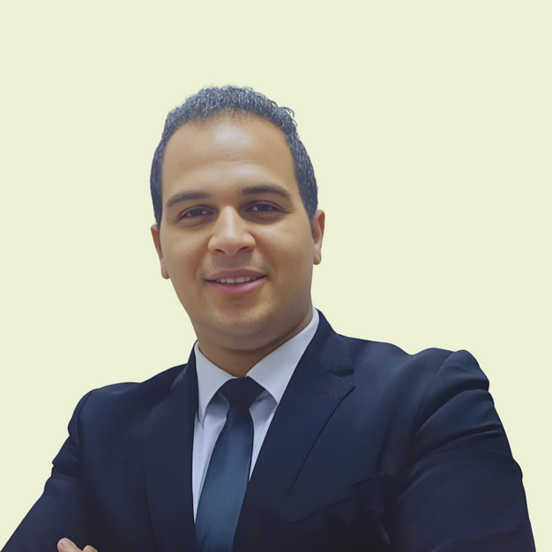

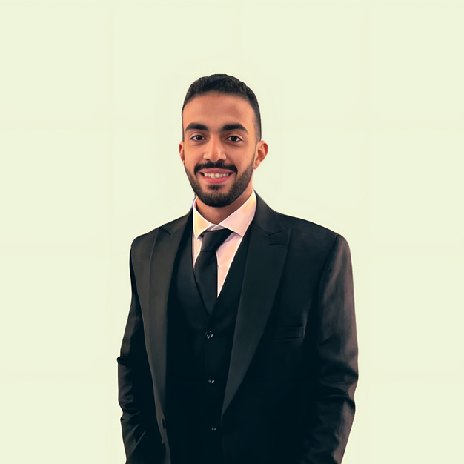
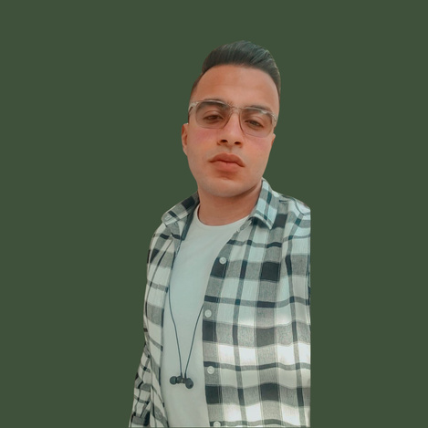

Our
Team
Members
E - scoot project

Slide 4
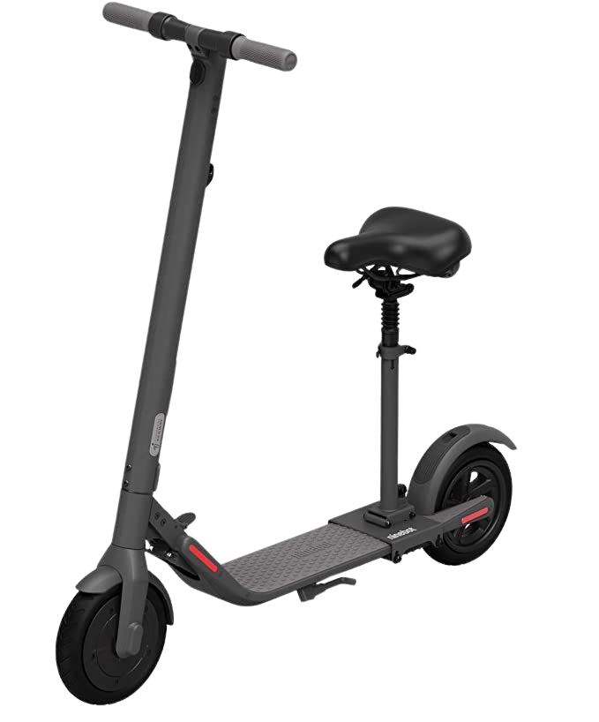
E-scoot Brief
Our company specializes in offering high-quality electric scooters. Our scooters are known for their energy efficiency, easy charging, low pollution, and minimal maintenance and operating costs.
We focus on incorporating modern technologies into our products, such as fast-charging systems, long-life batteries, and integration with smartphone applications for vehicle monitoring.
Additionally, our scooters are equipped with front fans for enhanced comfort.Our company was founded with the vision of revolutionizing personal transportation by providing sustainable and cost-effective mobility solutions.

Slide 5









Market Reasearch

Slide 6


SHARED IN MOBILITY REPORT 2023
Full Report

Slide 7
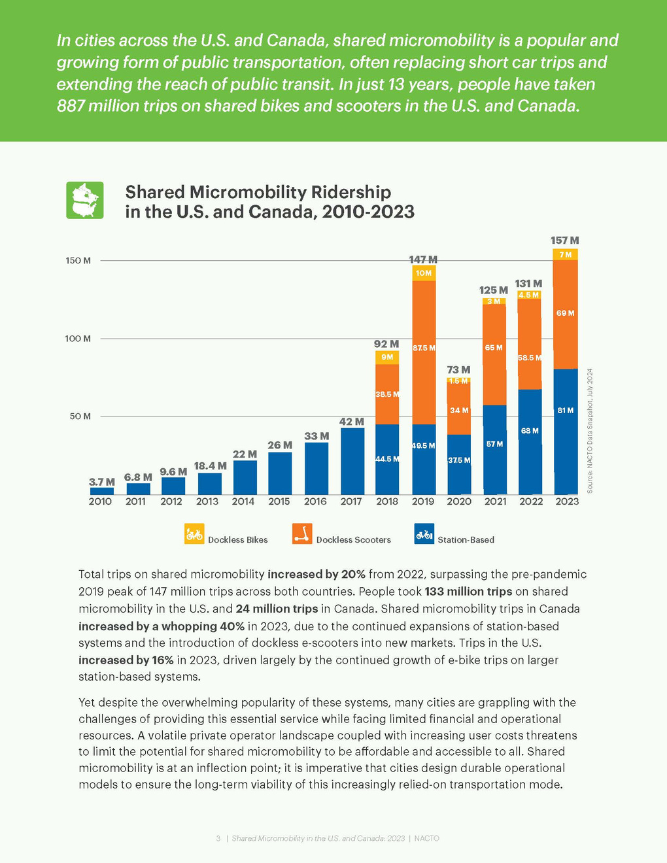
SHARED IN MOBILITY REPORT 2023
INCREASED RIDERSHIP
E-SCOOTER TRIPS ROSE BY 15% IN 2023. IN CANADA, RIDERSHIP JUMPED FROM 2 MILLION IN 2022 TO 4 MILLION, MAKING UP 17% OF THE COUNTRY'S SHARED MICROMOBILITY USAGE.
DOCKLESS E-BIKE EXPANSION
WHILE E-SCOOTER RIDERSHIP IS CLIMBING, DOCKLESS E-BIKES REMAIN THE SMALLEST SEGMENT. CANADA SAW A NEARLY FOURFOLD INCREASE IN TRIPS (FROM LESS THAN 100,000 TO 300,000), AND THE U.S. EXPERIENCED A 50% RISE (FROM 4.5 MILLION TO 6.7 MILLION TRIPS).

Slide 8
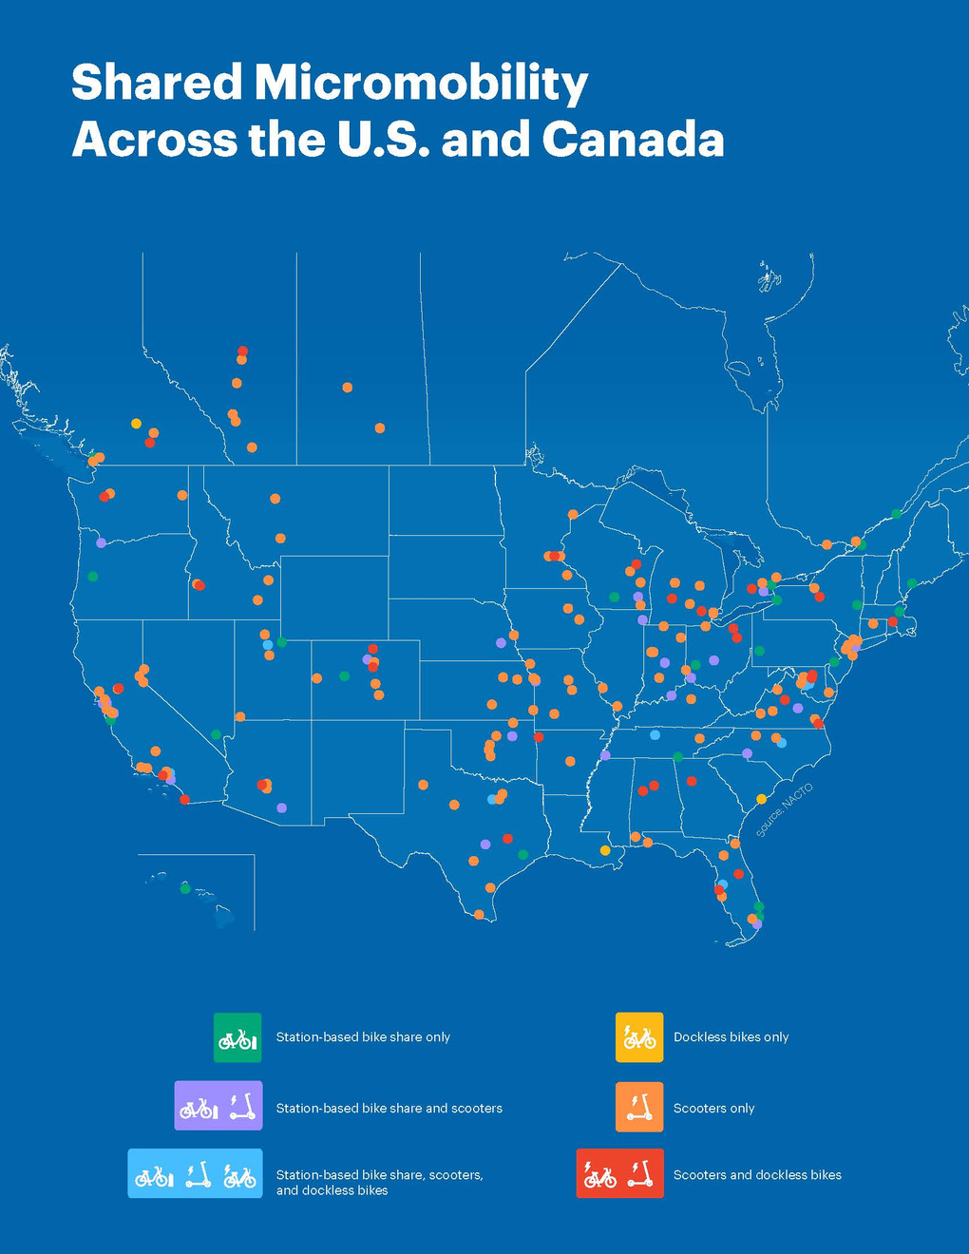
SHARED IN MOBILITY REPORT 2023
FUNDING ISSUES
SHARED MICROMOBILITY SYSTEMS ARE FACING FINANCIAL INSTABILITY, LEADING TO BANKRUPTCIES, JOB LOSSES, AND RISING COSTS FOR USERS, MAKING THEM LESS AFFORDABLE THAN TRADITIONAL PUBLIC TRANSPORT.

Slide 9
Brand Guidelines
Branding

Slide 10


Brand
Guidelines
Logo Guidelines
Logogram
Logogram + Logotype
Scooter
E-Scoot
Electric

Slide 11

Brand Guidelines
Color Guidelines
EDF1D6
609966
9DC08B
40513B

Slide 12
Aa
Brand Guidelines
A DEVICE FONT
BY E-SCOOT TEAM
CAIRO
Font Style
Heading
ZEBRAS CAOLHAS DE JAVA QUEREM PASSAR FAX PARA MOÇAS GIGANTES DE NEW YORK
The quick brown fox jumps over the lazy dog
1234567890&$#@!~

Slide 13





Brand Guidelines
Voice and Tone
Our brand voice is friendly, and we choose this type of tone because 60% of
our targeting is youth reflecting our commitment to exceptional customer service. Our tone adapts depending on the context and audience.

Slide 14

S
W
WEAKNESSES
STRENGTHS
Our current website needs improvement.
It's challenging to find spare parts at affordable prices.
We require a significant
amount of capital.
We offer a warranty on scooter parts
Our after-sales service is reliable
Our scooters use modern batteries that make them more efficient in energy consumption
O
T
OPPORTUNITIES
THREATS
The e-scooter market is growing due to increased environmental awareness.
We can seek partnerships with suppliers to improve our offerings and offer discounts to customers.
Participating in e-vehicle events can help us reach more customers.
Economic changes may reduce customers' purchasing power.
Rapid technological advancements could change customer preferences.
Competition from large online and local stores is a significant threat.

Slide 15



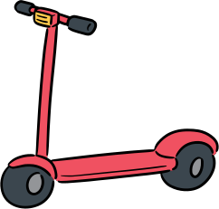









4PS: Product,Price,place,promotion
Product
01
Start
Our electric scooters are high-quality, featuring modern design for energy efficiency, easy charging, low pollution, and minimal maintenance costs, with regular updates to meet customer needs.
02
Price
Place
03
Our pricing, competitive due to importing, offers the best market prices, varying based on features and materials to cater to all budget ranges.
Located in New Cairo, Egypt, specifically in Nuzha New, attracting a niche group interested in electric transportation.
04
promotion
We are well-known in the electrical field, employing effective promotion strategies that highlight the benefits and features of our scooters to increase visibility.

Slide 16
Brand Guidelines
Buyer
Persona

Slide 17
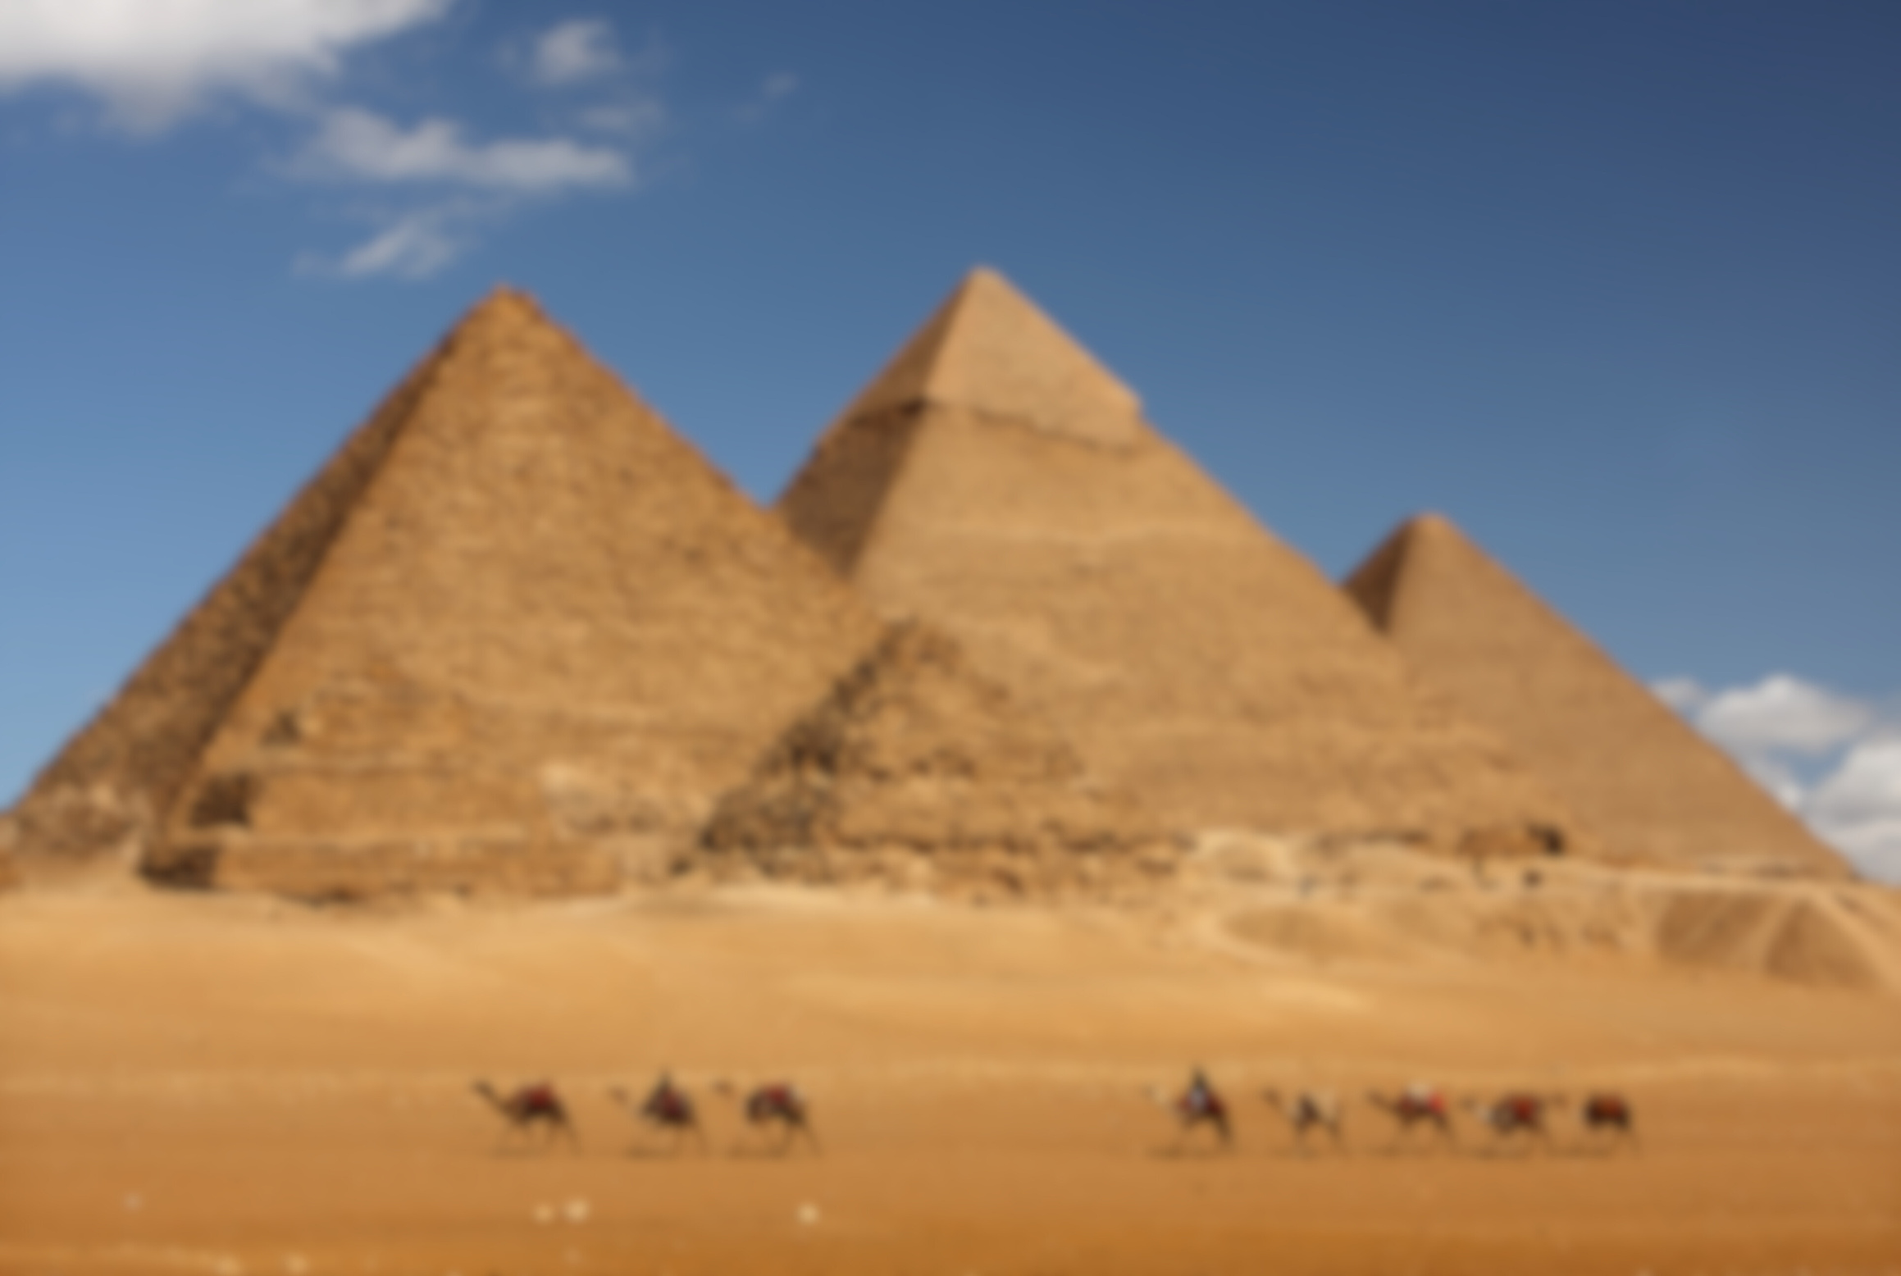


This is Omar
Hassan
Age: 30
Occupation: Urban Professional
Location: Cairo, Egypt
Income: 12,000 EGP/month
Tech Savviness: High
Commute Distance: 10-15 km/day
Marital Status: Single

Slide 18

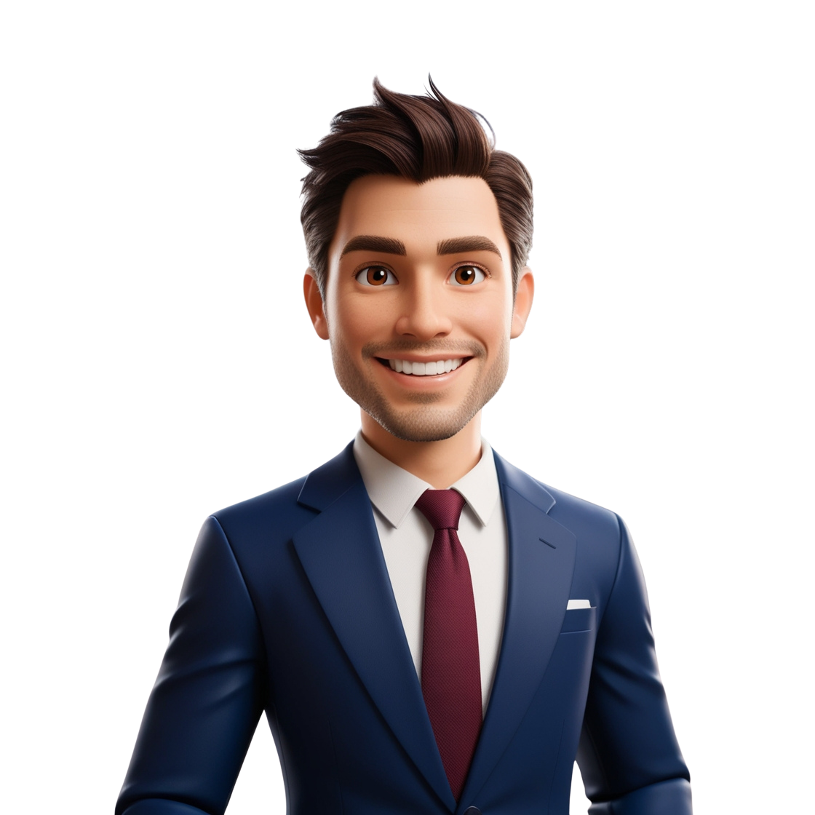
Background And Motivations
Omar is a tech-savvy professional living in Cairo. He commutes daily and wants to save time, money, and reduce his carbon footprint. An e-scooter appeals to him for its convenience, eco-friendliness, and ability to beat traffic. However, he’s concerned about road safety and limited charging infrastructure.

Slide 19

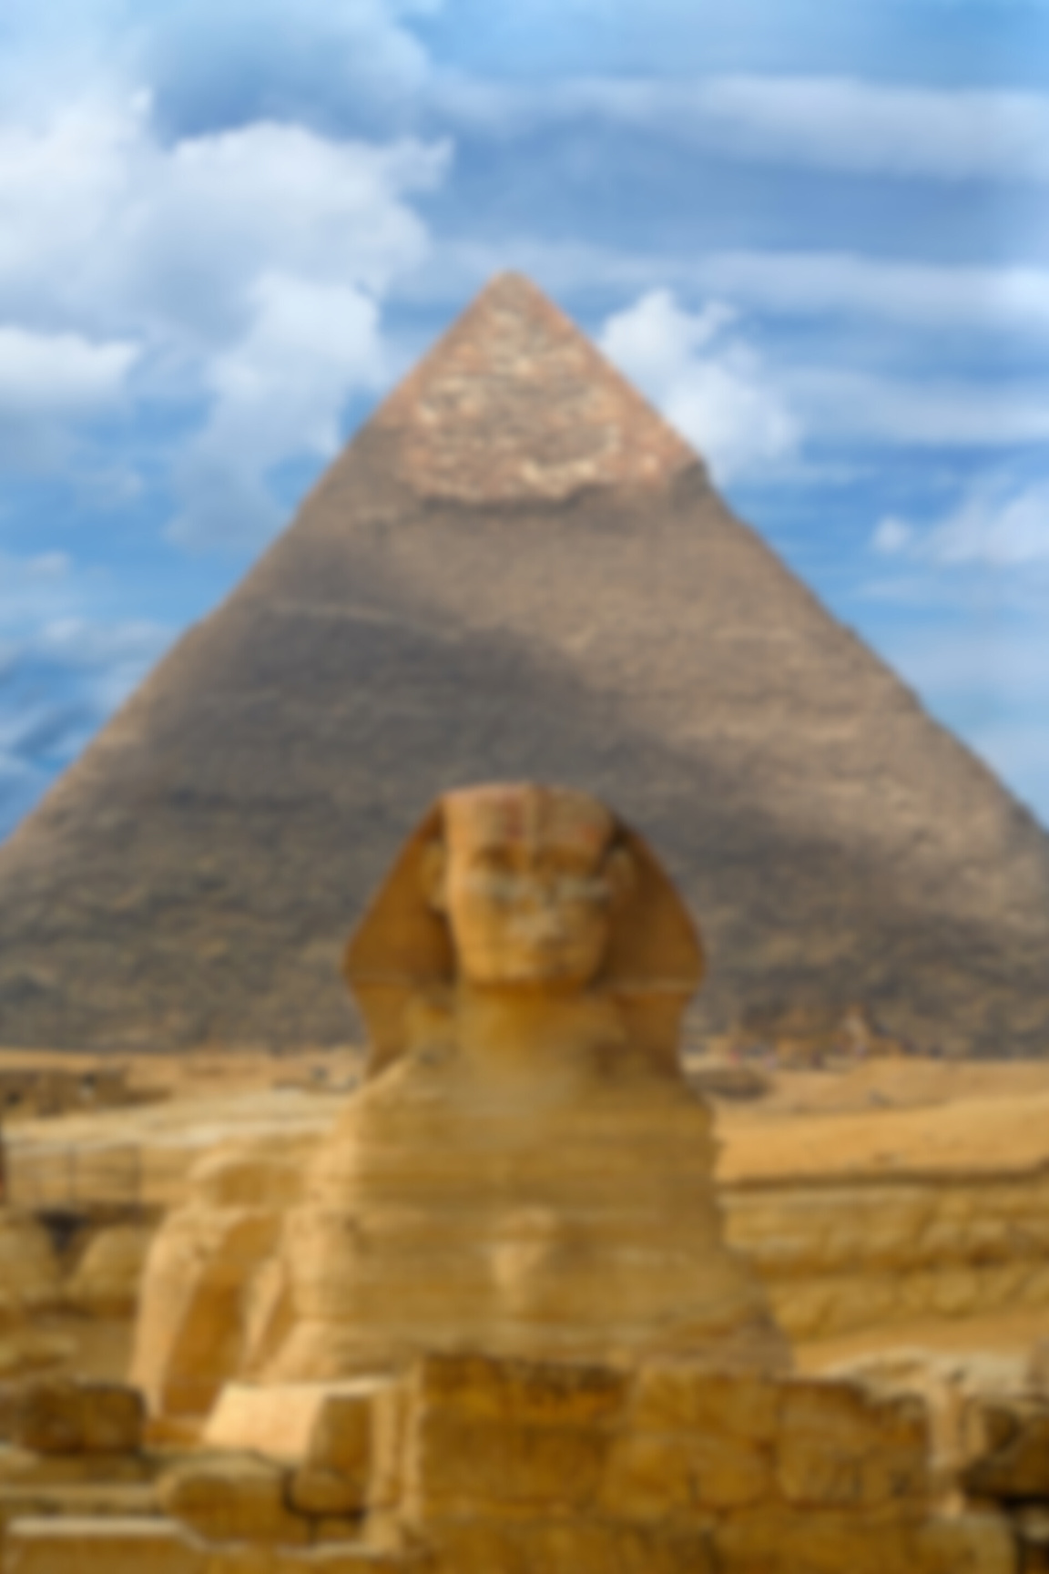
Challenges and Buying Behaviors
Omar prioritizes durability and cost-efficiency but is wary of high upfront costs. He relies heavily on online reviews, comparisons, and friend recommendations. Installment payment options are important to him.

Slide 20


Goals And Objectives
Omar aims to reduce commuting time and expenses while supporting a sustainable lifestyle with a reliable, long-lasting e-scooter.

Slide 21
Analysis
Competitve Analysis

Slide 22
Competitive Analysis
1
Review our brand and competitors.
2
List key attributes.
Competitive analysis allows us to understand where we are as a brand and how our competitors work. We will start by identifying who we are and who our competitors are.
Next, we will identify attributes they are doing right and create a perceptual map. In the perceptual map, we will identify a criteria and rank these attributes as high or low.
3
Identify criteria and rank attributes as high or low.
4
Tool Used to Collect Competitors Data : Fanpage Karma

Slide 23



Brand Review and Attributes
Easy Go
At Easy Go, we are passionate about motorcycles, bikes, and scooters. Our goal has been to provide our customers with a one-stop-shop for all their wheel transportation needs, specially two, three-wheel.
founded 2024
profile

Slide 24


STATISTICS
5.8k
20%
5.6
Followers
Engagement percentage
post per week
5 person
0.8
0.79
Admins
post per day
frequency
54k
0.26%
ads value
post Interaction

Slide 25
Brand Review and Attributes
At دوس كهرباء , we are passionate about motorcycles, bikes, and scooters. Our goal has been to provide our customers with a one-stop-shop for all their wheel transportation needs, specially two, three-wheel.
دوس كهرباء
founded 2023
profile

Slide 26
STATISTICS
1.8k
11%
0.49
Followers
Engagement percentage
post per week
2 person
.07
0.071
Admins
post per day
frequency
13k
1.5%
ads value
post Interaction

Slide 27
Brand Review and Attributes
At One Electric Scooters , we are passionate about motorcycles, bikes, and scooters. Our goal has been to provide our customers with a one-stop-shop for all their wheel transportation needs, specially two, three-wheel.
One Electric Scooters
profile
founded 2021

Slide 28
STATISTICS
3.2k
58%
1.4
Followers
Engagement percentage
post per week
3 person
0.2
0.21
Admins
post per day
frequency
198k
2.7%
ads value
post Interaction

Slide 29
Brand Review and Attributes
At Auto Ride, we are passionate about motorcycles, bikes, and scooters. Our goal has been to provide our customers with a one-stop-shop for all their wheel transportation needs, specially two, three-wheel.
Auto Ride
founded 2016
profile

Slide 30
STATISTICS
28k
44%
7
Followers
Engagement percentage
post per week
15 person
1
1
Admins
post per day
frequency
300K
0.42%
ads value
post Interaction

Slide 31
Media Plan

Slide 32



07
Brand Guidelines
Our Objective
Within 6 months, introduce the E-scoot brand to the Egyptian market by increasing brand awareness among men and women aged 18-30, achieving a 50% increase in brand recognition, reaching 500,000 unique individuals, generating 50,000 website visits, and maintaining a 2% CTR across all digital platforms, with a total budget of 1 million Egyptian pounds.

Slide 33





TARGET AUDINCE
The target audience for the E-scooter brand, as defined in the media plan, includes the following characteristics:
01
03
DEMOGRAPHICS:
PSYCHOLOGICAL CHARACTERISTICS
Gender: Men and Women
Age: 18-30
Optimistic, Self-confident, Involved, Outgoing, Growth-oriented, Open to change, Established & emerging leaders in business & government
02
04
LIFESTYLE CHARACTERISTICS
CONSUMER CHARACTERISTICS
Successful, sophisticated Value personal growth, Wide intellectual interests, Varied leisure activities, Well-informed, concerned
with social issues, Highly social.
Enjoy the "finer things", Receptive to new products,, technologies, distribution, Skeptical of advertising, Frequent readers of a wide variety of publications, Light TV viewers

Slide 34



Digital Channels:
Social Media: Facebook, Instagram, TikTok (Managed via Hootsuite)
Search Engine Marketing (SEM): Google Ads for search and display campaigns
OUR CHANNELS
TRADITIONAL
Outdoor Billboards: Strategic placements in urban areas where E-scooters are popular.
Locations: 6 October, October Bridge,Tagamoa
The media channels selected for
the E-scooter brand
INFLUENCER MARKETING
Use Influencer Marketing:
Ahmed El Wakil: Instagram, Amr Hafez: Instagram
Deals will involve exclusive discounts for their followers and content that highlights the scooter’s luxury and performance.

Slide 35

Content Creation & Production
20,000 EGP
Contingency & Testing:
20,000 EGP
Social Media
160,000 EGP
SEM
200,000 EGP
BUDGET ALLOCATION
Influencer Marketing
100,000 EGP
Reel Production for Social Media
100,000 EGP
Outdoor Billboards 200,000 EGP
1,000,000 EGP

Slide 36









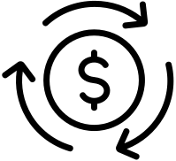




KEY PERFORMANCE INDICATORS (KPIS)
reach
return on ad spend (ROAS).
is the total number of unique people who have seen your content.
metric that measures the revenue generated for every dollar spent on advertising. It indicates the effectiveness of your ad campaigns.
CTR
conversions
the interaction users have with your content, such as likes, comments, shares, and clicks.
actions taken by users that fulfill a desired goal, such as making a purchase, signing up for a newsletter, or filling out a form.
engagement
impressions
the interaction users have with your content, such as likes, comments, shares, and clicks.
the percentage of people who click on a link or ad out of the total number who see it.

Slide 37
Content Plan

Slide 38
SALES FUNNEL
01
02
AWARENESS
customers aware of the brand
03
CONSIDERATION
Engage with the audience
CONVERSION
Encourage the audience to make a purchase
04
Loyalty
make a Re purchase

Slide 39
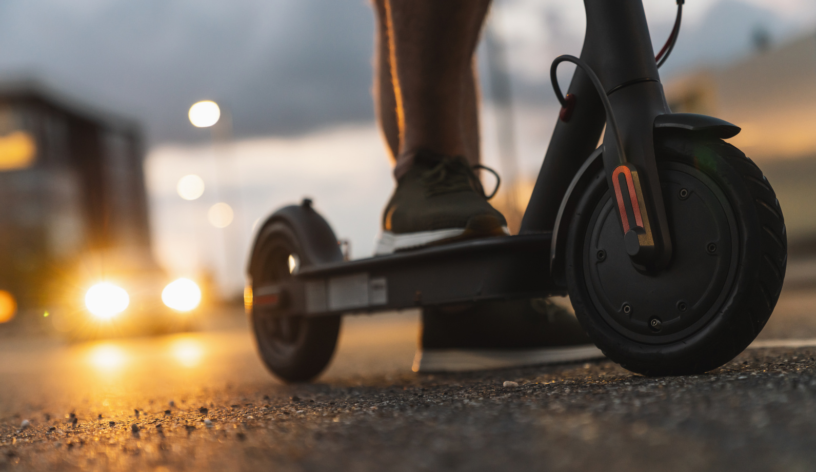
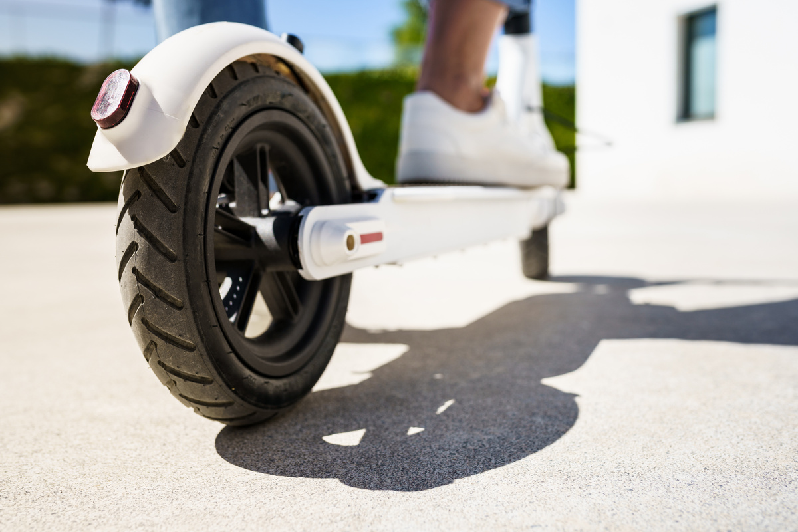
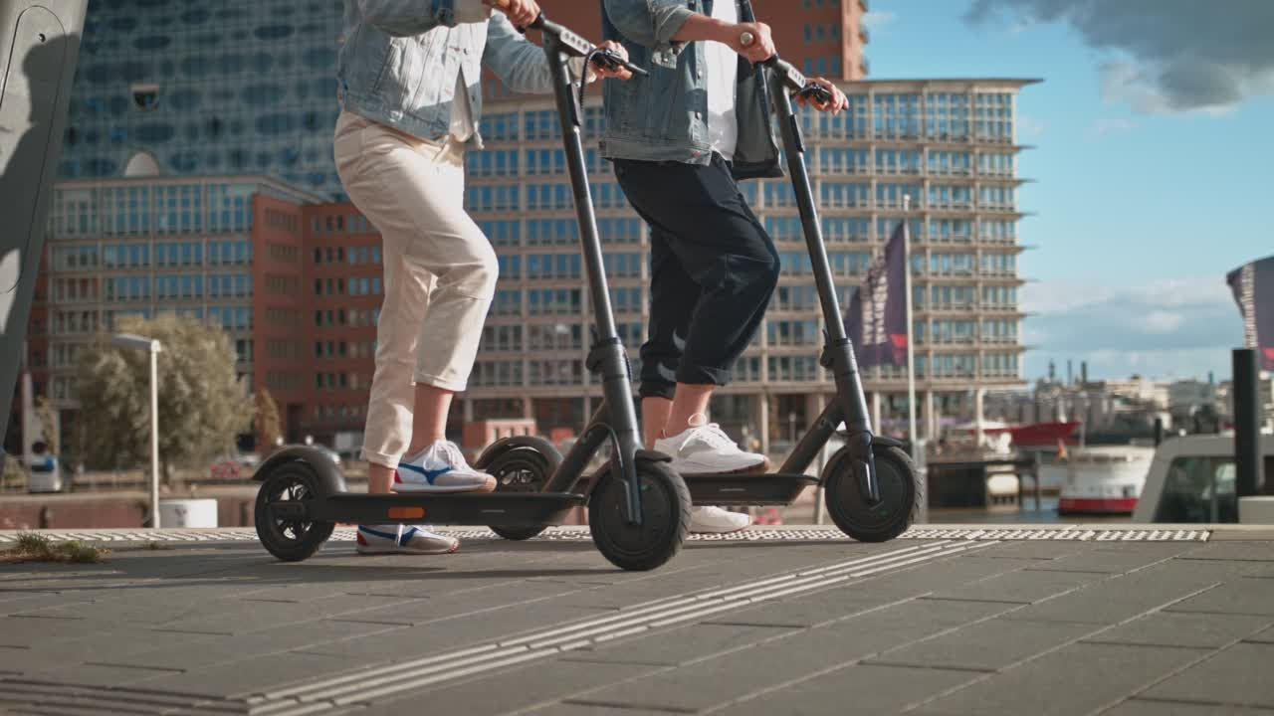
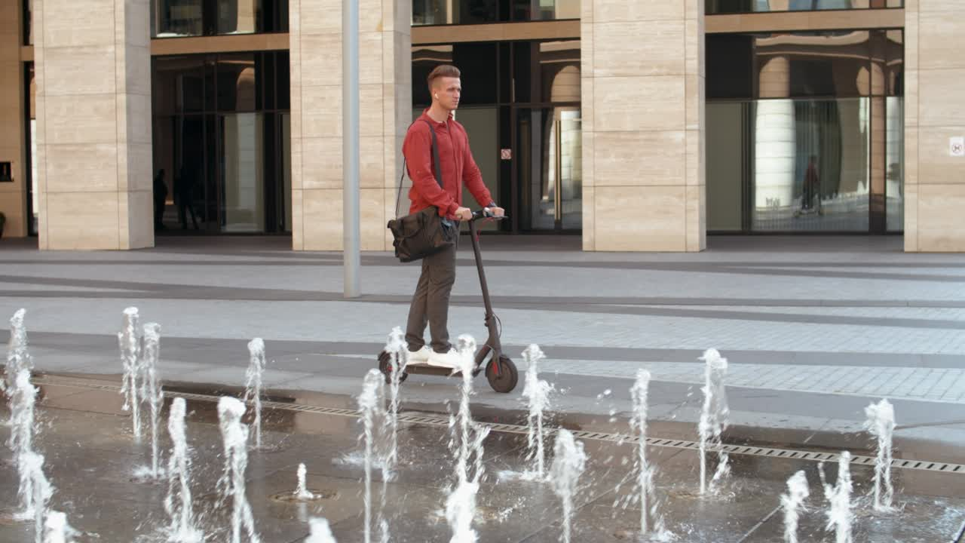
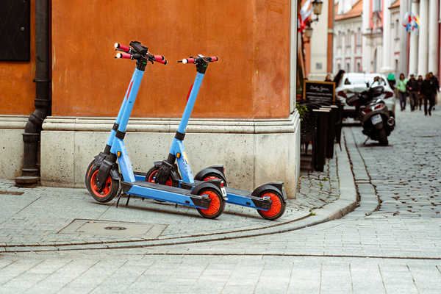
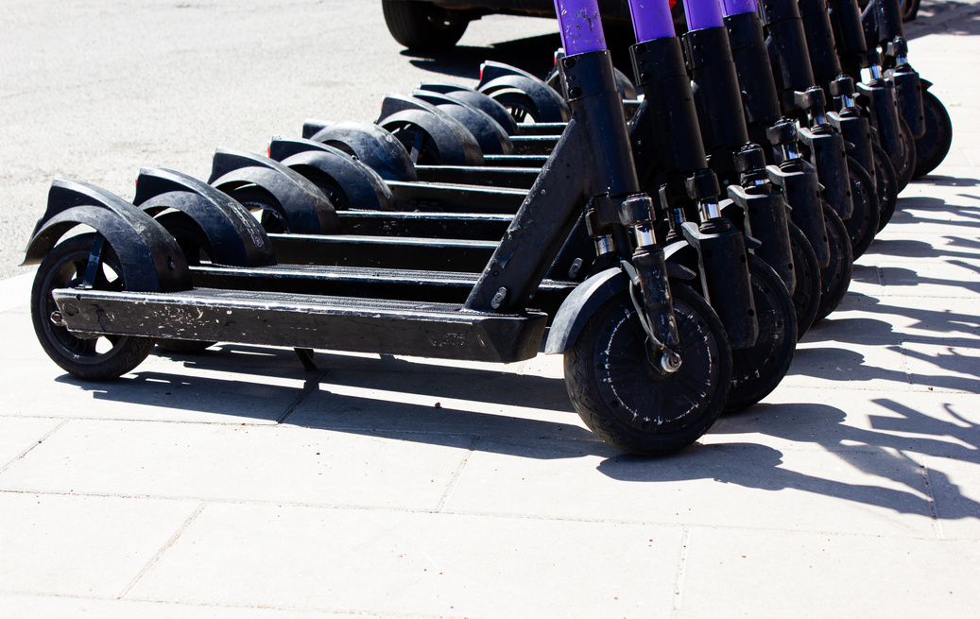
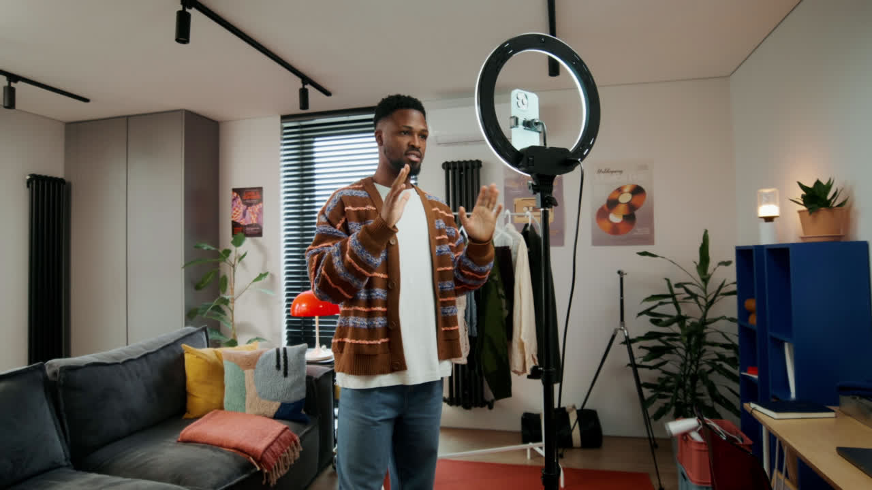

PRE-LAUNCH AWARENESS (AWARENESS STAGE)
1 month
Month : October
DAY & TIME
MONDAY
10:00 AM
TUESDAY
2:30 PM
WEDNESDAY
12:00 PM
THURSDAY
3:45 PM
FRIDAY
1:15 PM
SATURDAY
11:00 AM
SUNDAY
5:00 PM
VISUAL
Text post
carousel
Video
Video
Carousel
Text Post
Live
PLATFORM
Facebook
Instagram
Facebook
Tiktok
Instagram
Facebook
Tiktok
CAPTION
"Embrace the future of urban mobility with our electric scooters! 🚀✨ Eco-friendly, efficient, and stylish – your ride has never been this smooth. 🌿⚡
Discover the power of electric scooters. Eco-friendly, efficient, and fun!
Experience the future of transportation with our electric scooters! 🌿⚡ Eco-friendly, stylish, and efficient – your perfect ride awaits. Glide through your city with ease and sustainability. Join the revolution today! 🛴💨
"Ready to ride the future? 🚀⚡ Hop on our electric scooters for an eco-friendly, stylish, and smooth journey. Let's make commuting fun again! 🌿🛴”
Say goodbye to traffic and hello to freedom. Ride with us today!
"Experience the freedom of the future with our electric scooters! ⚡🌿 Glide through the city with ease, style, and sustainability. Join the revolution in urban mobility today! 🛴💨
Hey everyone! 🚀 Ready to transform your commute? Join us live as we showcase our eco-friendly, stylish electric scooters! 🌿🛴 Discover how you can ride smarter and greener. Let's revolutionize urban mobility together! 💚⚡
HASHTAGS
#EcoRide
escoot
#ElectricScooter
#UrbanMobility
#RideTheFuture
#EcoFriendly
#RideGreen
#ElectricScooter
NOTES
GOALS

Slide 40











OUR DIGITAL MARKETING CHANNEL
SOCIAL MEDIA
E-commerce
we well use social media platform
like (instgram, Facebook)
we have our own ecommerce
that will help customer to know more about own product and we can know more our customer behavior by using pexil
Influencer Marketing
Seo / Sem
we gonna use influencer to make brad awareness for our brand
we will use search angine optimziation that will help me to make other client know more about our brand
Email Marketing
Affiliate marketing program
we will try to attract our customer by using mail and inform them about our offers in future and our new products
we will make affiliate program that will help me track sale for the the seller and help me to increase sales

Slide 41
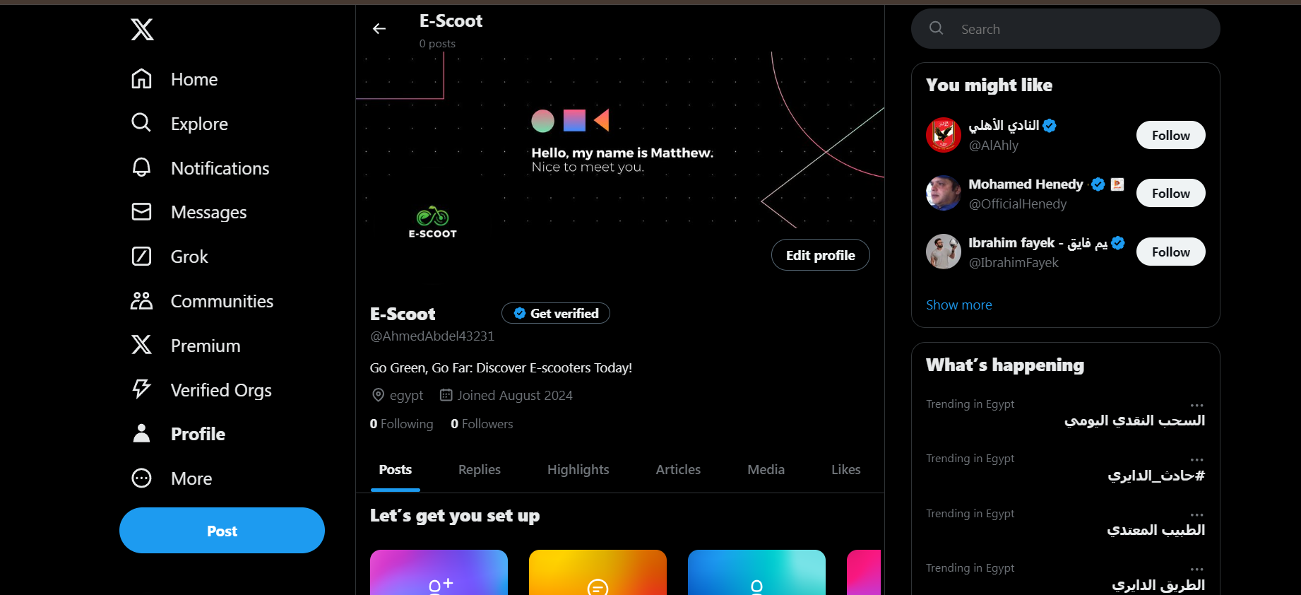
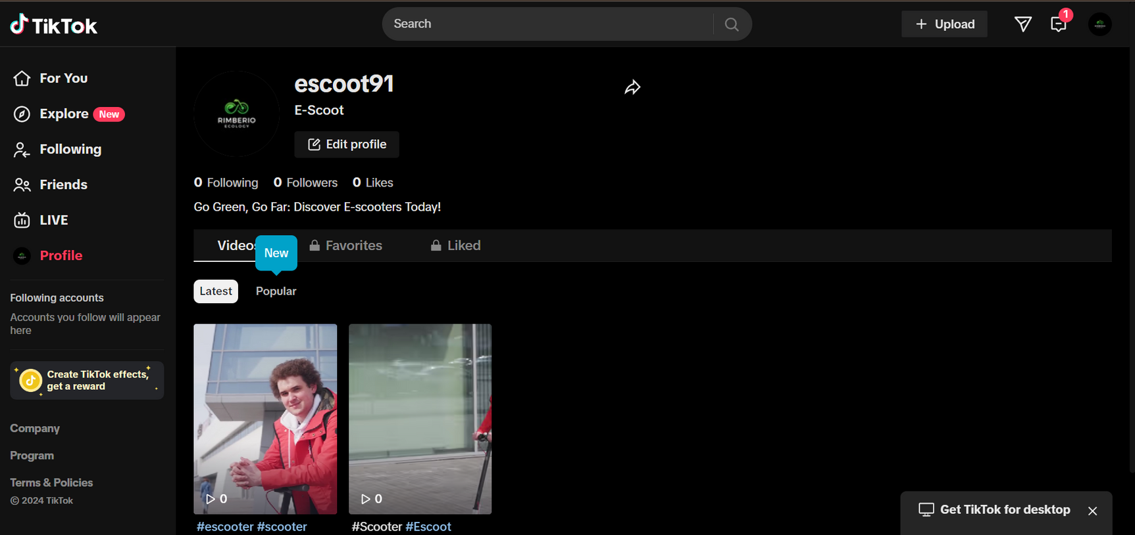
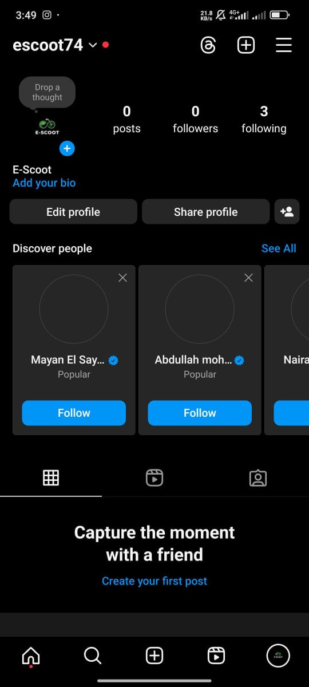
OUR SOCIAL MEDIA CHANNELS
X
TIKTOK
INSTAGRAM

Slide 42
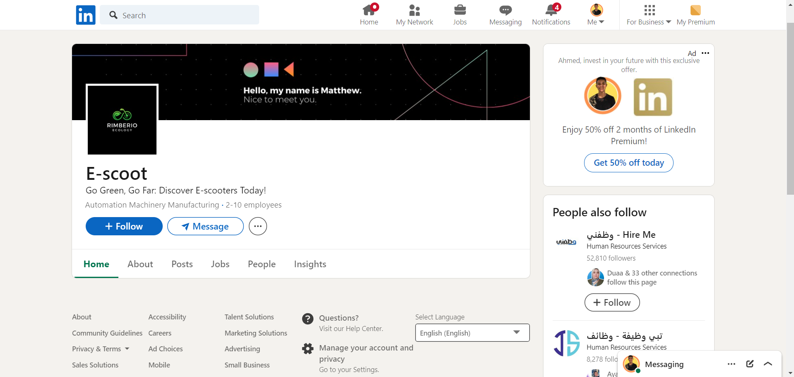
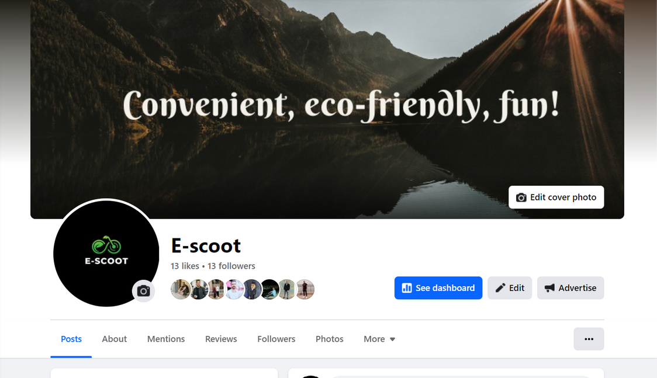
OUR SOCIAL MEDIA CHANNELS
LINKEDIN
FACEBOOK

Slide 43
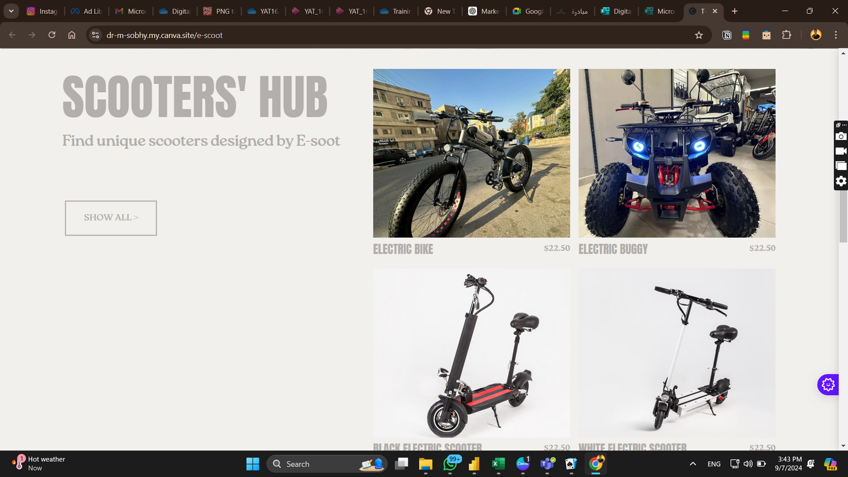
Website

Slide 44
Ads Result

Slide 45
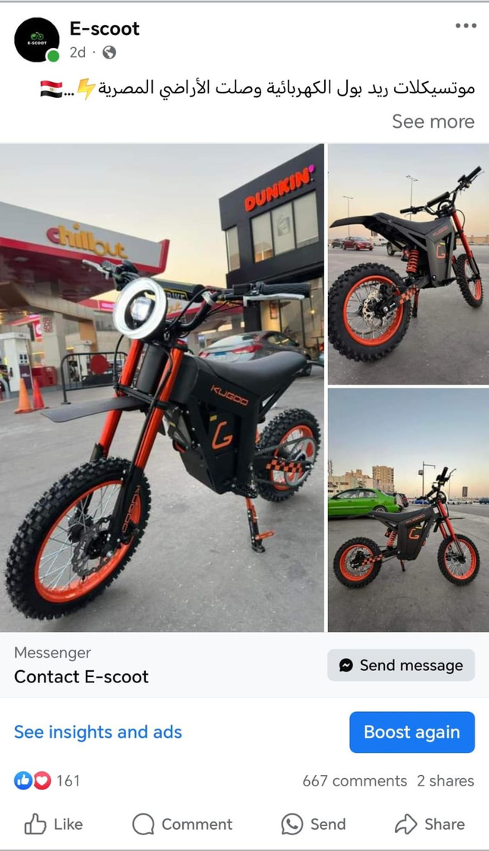
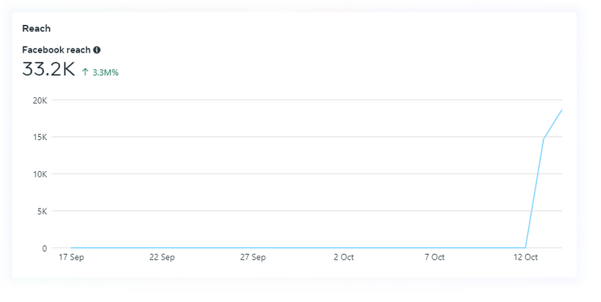
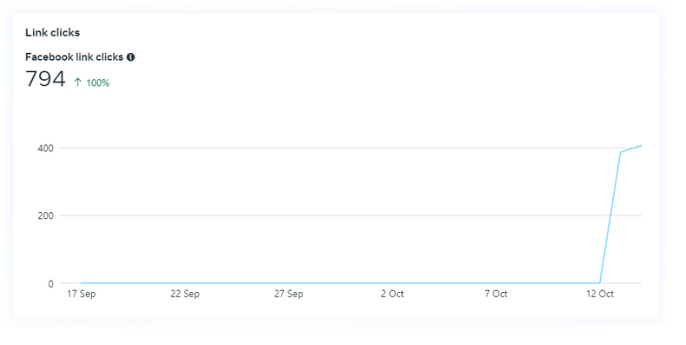
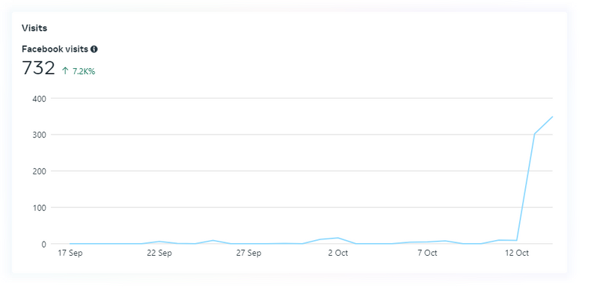
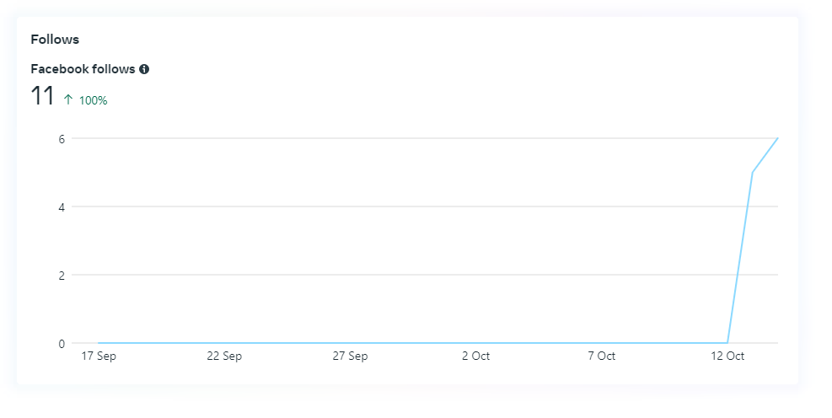
Facebook Post Ads

Slide 46
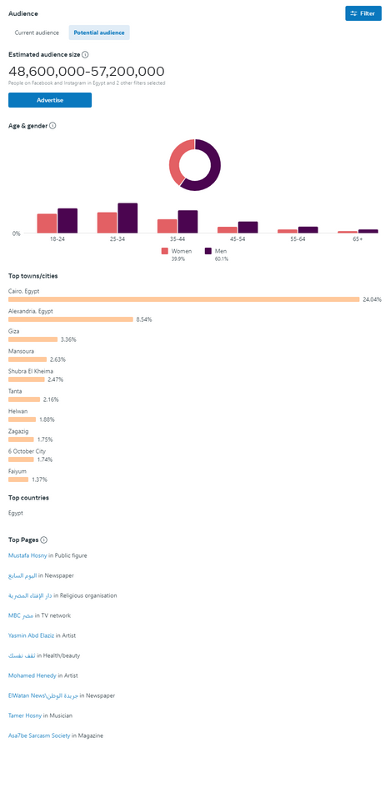
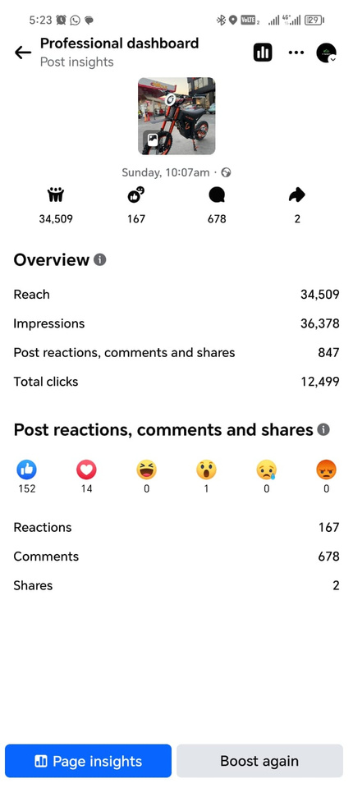
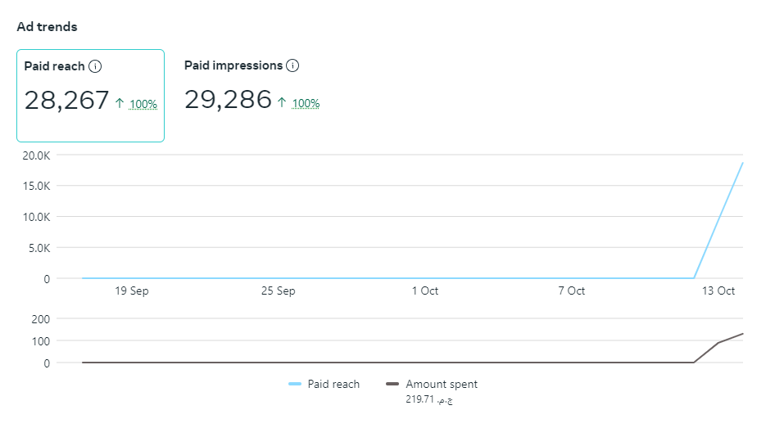
Facebook Post Ads

Slide 47
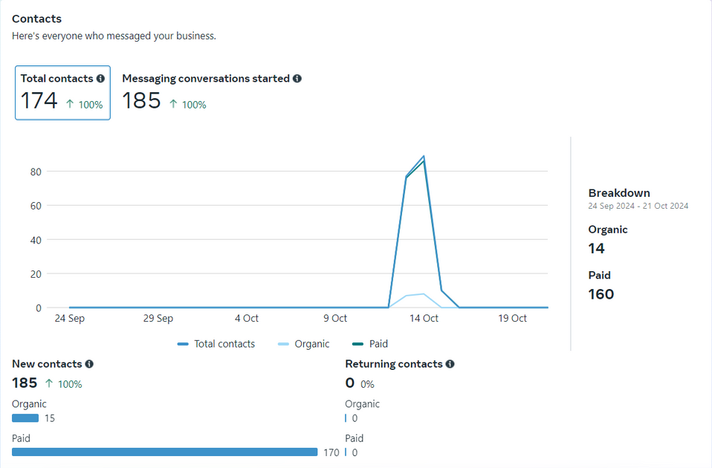
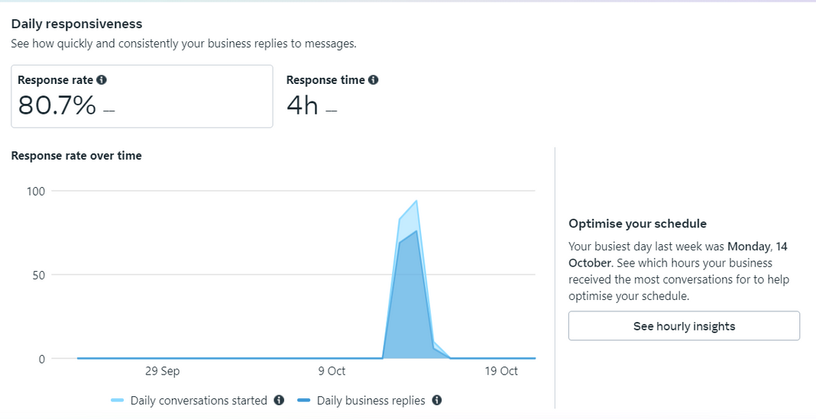
Facebook Post Ads

Slide 48
Recommendations and Improvements
More Dynamic Content
Move beyond just photos. We should introduce videos of real users, behind-the-scenes footage, and product features in action. Show how the Scooter performs on the streets with real commuters.
Add interactive elements like polls or quizzes to keep the audience engaged—something simple like, “Which E-scoot is right for you?”
Video Showcases
Prioritize videos over static images,short clips showing the E-scoot in real-life settings, focusing on smooth rides, features, and customer experiences.
Highlight Customer Experiences
Real riders telling their stories can boost trust. Let’s feature short clips or quotes from people who use E-scoot daily. Adding a feature like “Rider of the Month” will put the spotlight on customers
Customer Testimonials
Feature real riders, sharing their stories on how E-scoot has improved their daily commute, adding credibility to the brand.
Influencer Collaborations
Partner with influencers in the urban mobility or eco-friendly niche to reach a wider audience and create relatable content.
Video Showcases
Prioritize videos over static images,short clips showing the E-scoot in real-life settings, focusing on smooth rides, features, and customer experiences.
Interactive Posts
Use polls, Q&A sessions, or simple quizzes to get the audience engaged while highlighting the scooter’s key benefits.
Sustainability Focus
Push the eco-friendly benefits of E-scoot, emphasizing how it helps reduce emissions and save on transportation costs, tying in with global environmental initiatives.

Slide 49











Tools Used

